Slide 1
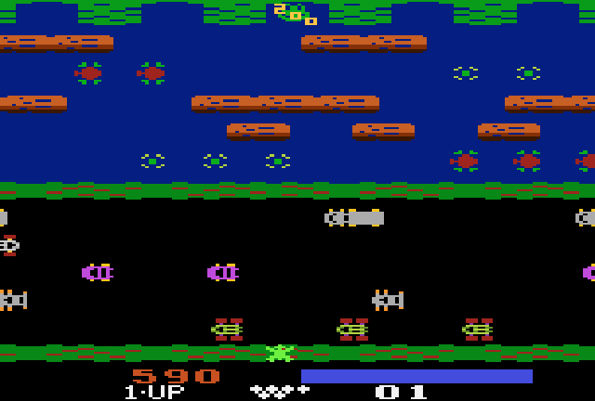
Frogger on the Atari 2600 (1981)

Slide 2
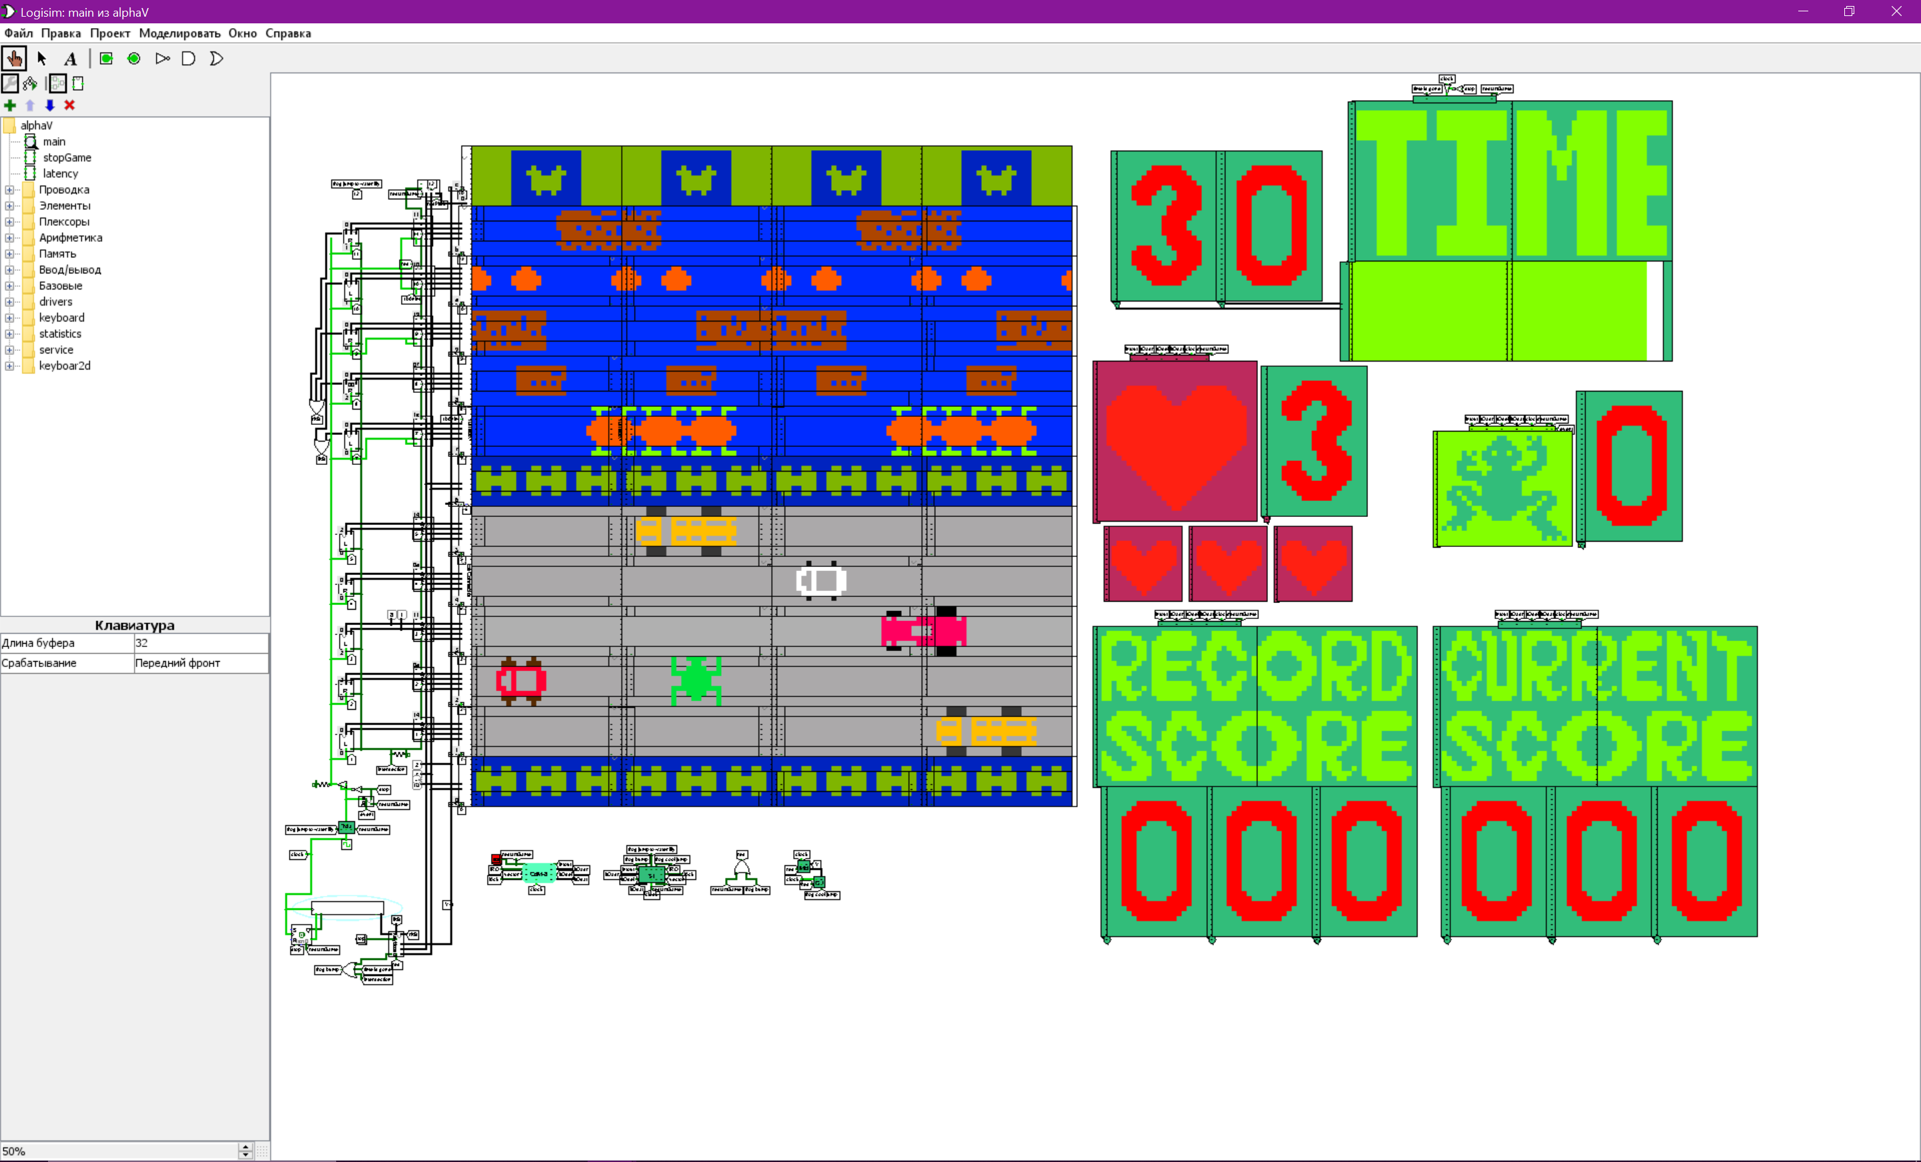
Frogger
Authors:
Dondokov Artem
Kuznetsov Gleb
Medvedeva Daria

Slide 3
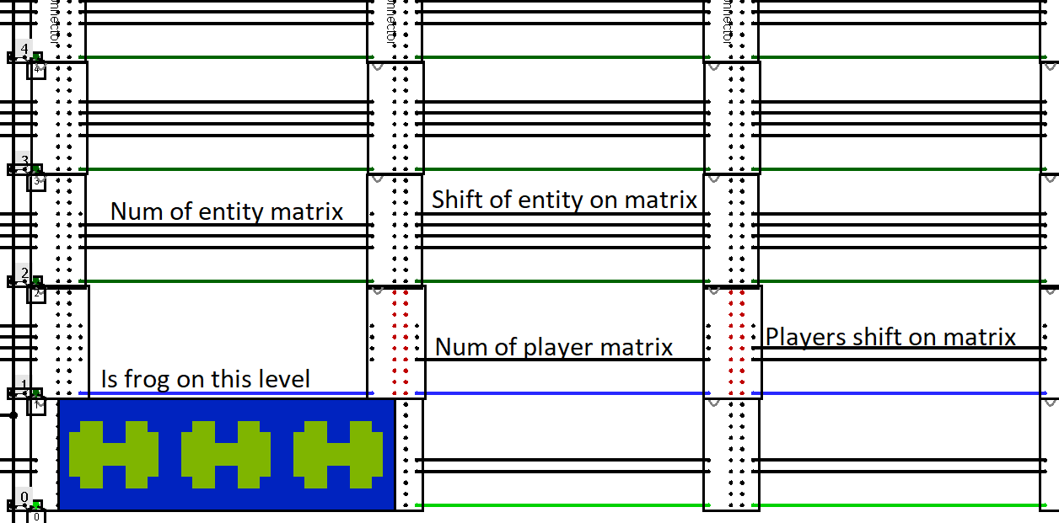

Slide 4
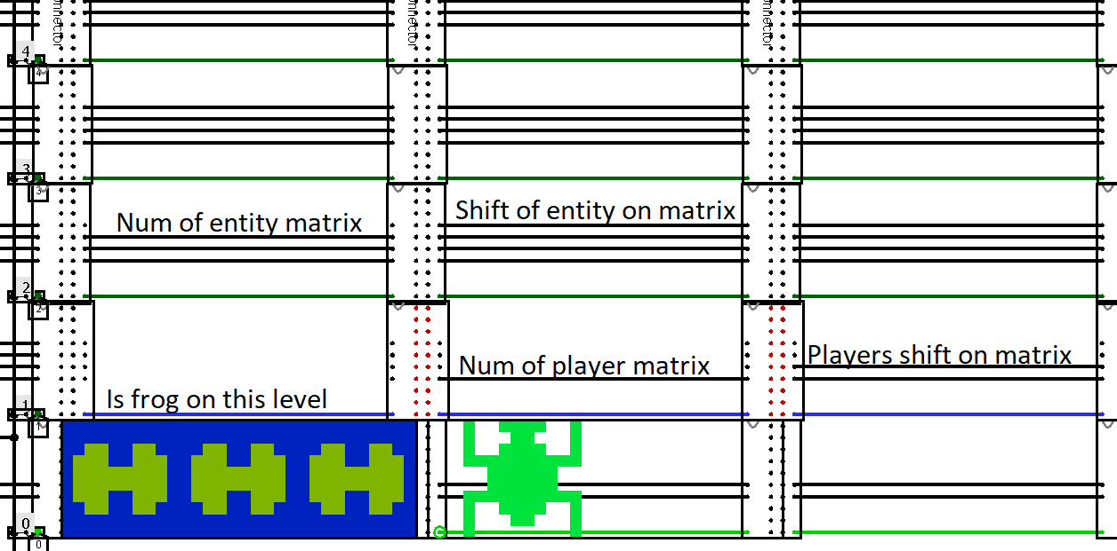

Slide 5
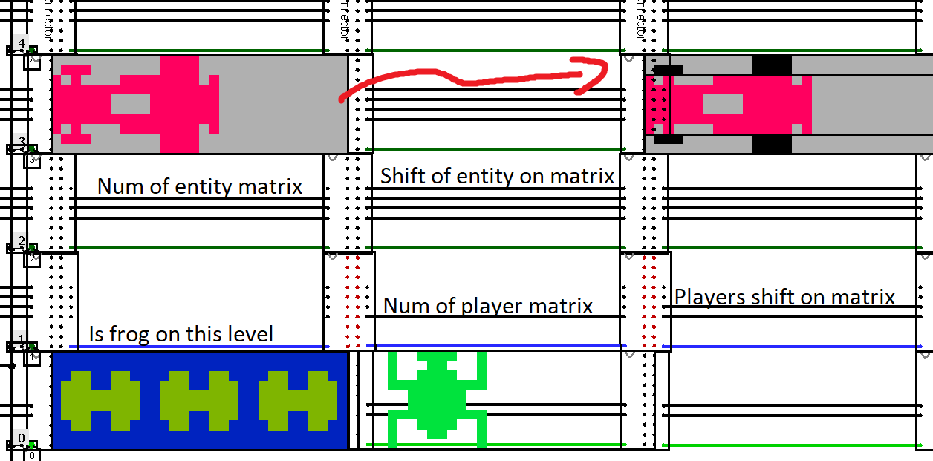

Slide 6
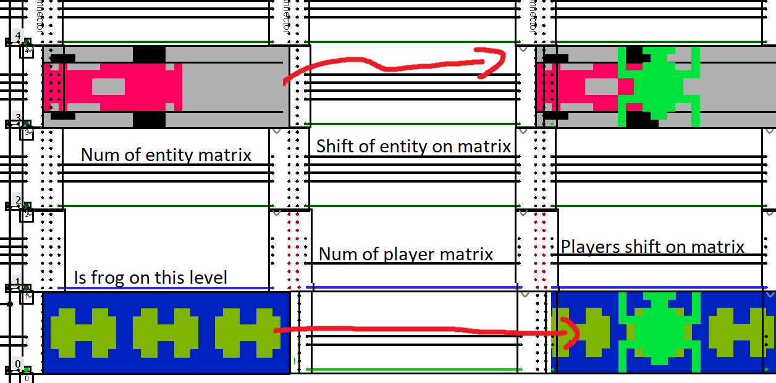

Slide 7
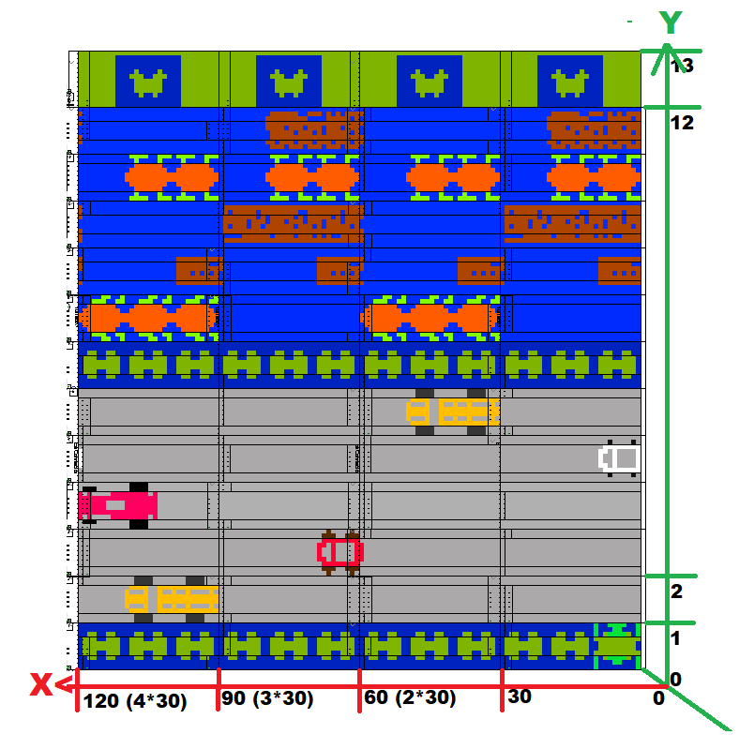

Slide 8
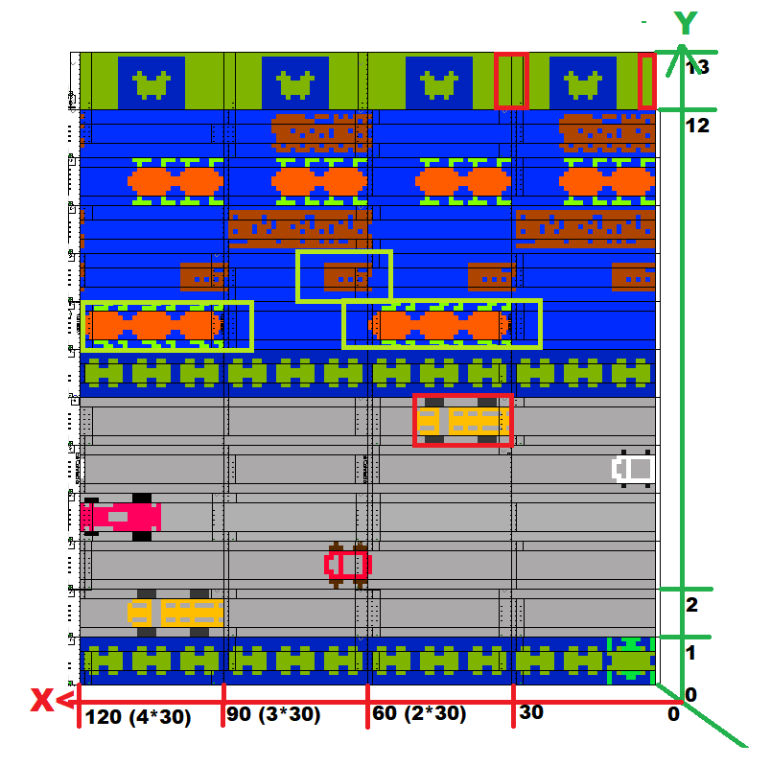

Slide 9
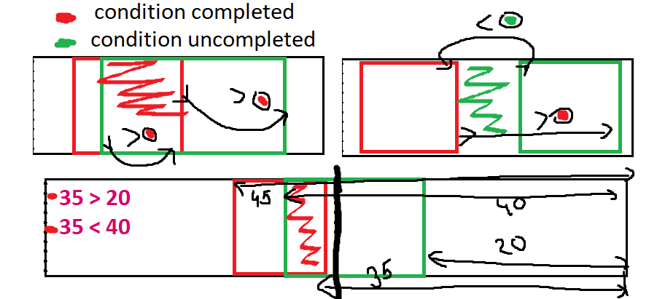

Slide 10
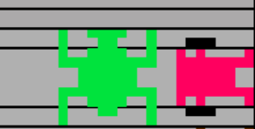
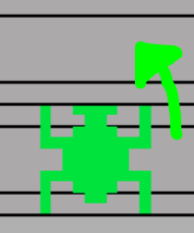

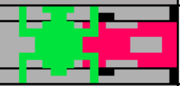
A bump
A good jump
A rescue

Slide 11
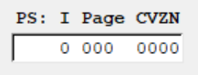

Bump Interrupt Vector
A pointer
PS register
0xBF
0b00000000
Address: 0xBF
Bump_ISR:
ldi r2, bump_flags_combo
ld r2, r3
inc r3
st r2, r3
rti
The number of missed interrupts

Slide 12
Semantic parts of the code:
Itialization,1 routine.
Checks, 3 routines.
Updates, 4 routines.
Interrupt Service Routines, 3 ones.

Slide 13


